Slide 1
Processor Expert & Project Structure
A quick recap

Slide 2
Processor Expert - Motivation
Rapid Application Generation Tool
Hardware Abstraction
Functionality is split into reusable components.
Components can be configured.
Object Oriented Approach, Components have:
Methods, procedures that can be executed.
Events that indicate state changes.
Properties that change the component behaviour.

Slide 3
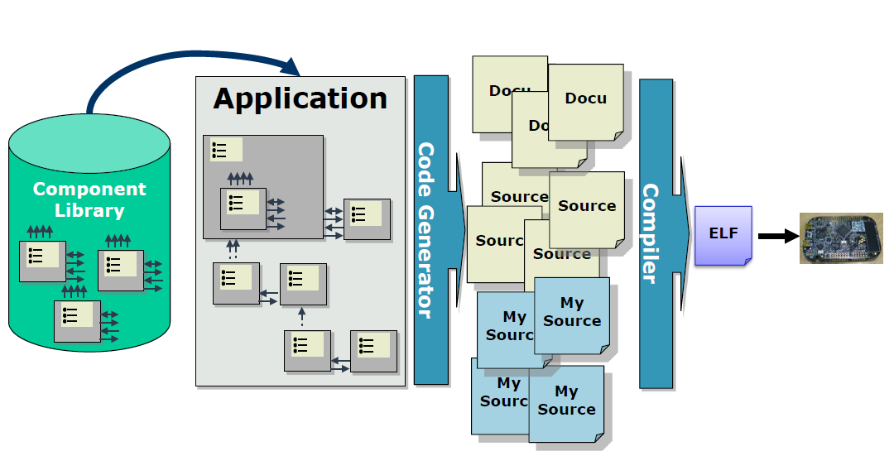
Processor Expert - Workflow

Slide 4
Processor Expert - Code Generation
Code is generated according to the ProcessorExpert.pe file.
It stores all the component-settings in the project.
IMPORTANT VCS Note:
Avoid coinflicts with ProcessorExpert.pe, not easy to merge.
Agree on component changes in group
User A does a change → Commit/Push
User B closes project, deletes .pe file → Pull

Slide 5
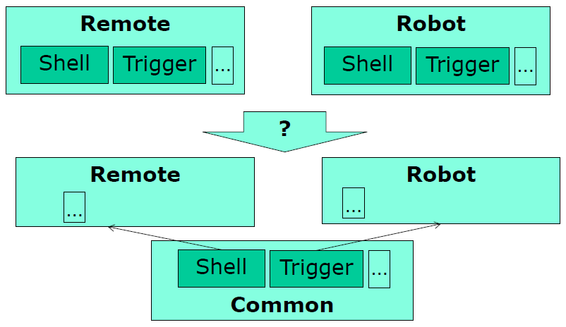
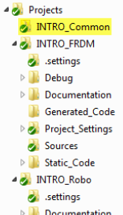
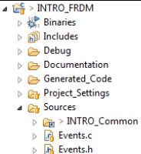
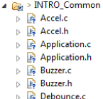
Project Structure – Linked Folders
Similar hardware used in the different systems.
Code can be reusable.

Slide 6
Project Structure - Platform.h
Common Project Configuration
Differences are set within Platform_Local.h
Platform.h Platform_Local.h
#if PL_LOCAL_CONFIG_BOARD_IS_ROBO #define PL_LOCAL_CONFIG_BOARD_IS_REMOTE (1)
#elif PL_LOCAL_CONFIG_BOARD_IS_REMOTE
#define PL_CONFIG_BOARD_IS_FRDM (0)
#define PL_CONFIG_BOARD_IS_REMOTE (1)
#define PL_CONFIG_BOARD_IS_ROBO (0)
#define PL_CONFIG_BOARD_IS_ROBO_V1 (0)
#define PL_CONFIG_BOARD_IS_ROBO_V2 (0)

Slide 7
Quiz
Why use Processor Expert?
Rapid Application Tool,
Saving a lot of time by eg. using a I2C component, rather than implementing one yourself
Name three components you can add with processor expert.
BitIO, LED, Wait, Shell, FreeRTOS …
What are the advantages and disadventages of linked folders?
Only write code once
You have to tell Eclipse where to find the folder
Can you think of a different solution to share code / system blocks?
Library (static), Duplicate (Copy)

